Slide 1
Topic: Scale Diagrams EQ: How do I use a scale diagram?
This is our next unit
Collect test paper
Collect your assessment outline- glue in or keep somewhere safe. Add in your Test 3 results.
Next assessment is PYTHAG, TRIG and BIVARIATE Test 3 on WEDNESDAY then EST

Slide 2
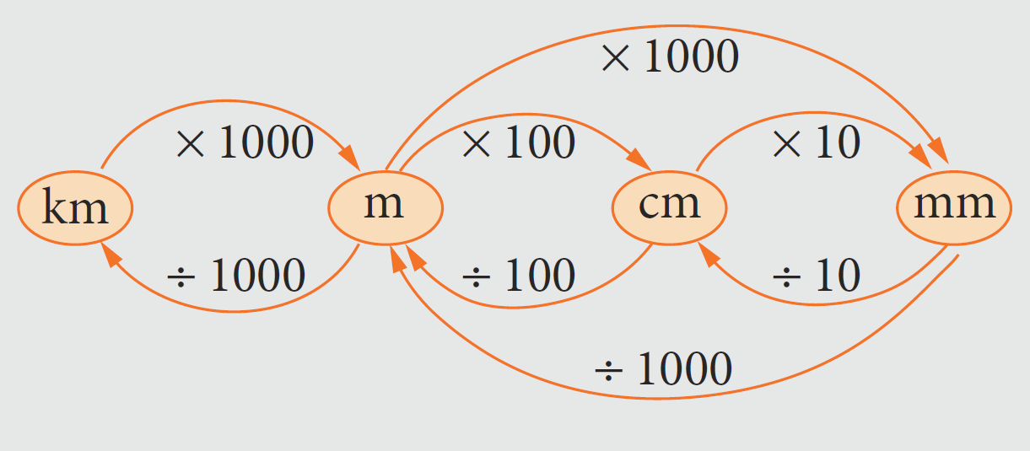
You may need this throughout this unit

Slide 3
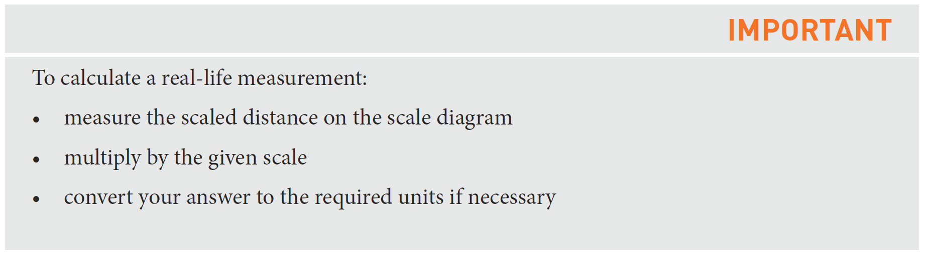
24
7
30
Scale Diagrams
Date
EQ – How do you use a scale diagram?
What is a scale diagram?
Is a reduced or enlarged version of a real object.
The most common scale diagrams are maps and house plans
How to use a scale diagram?

Slide 4
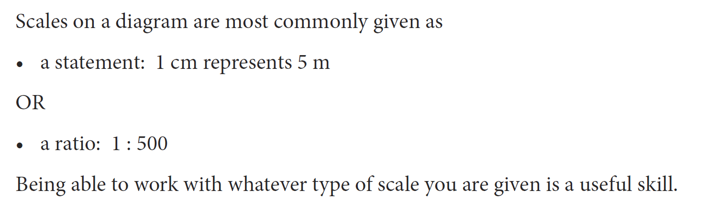

Slide 5
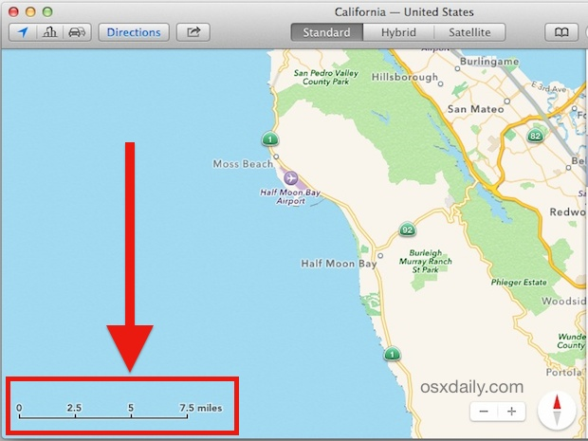
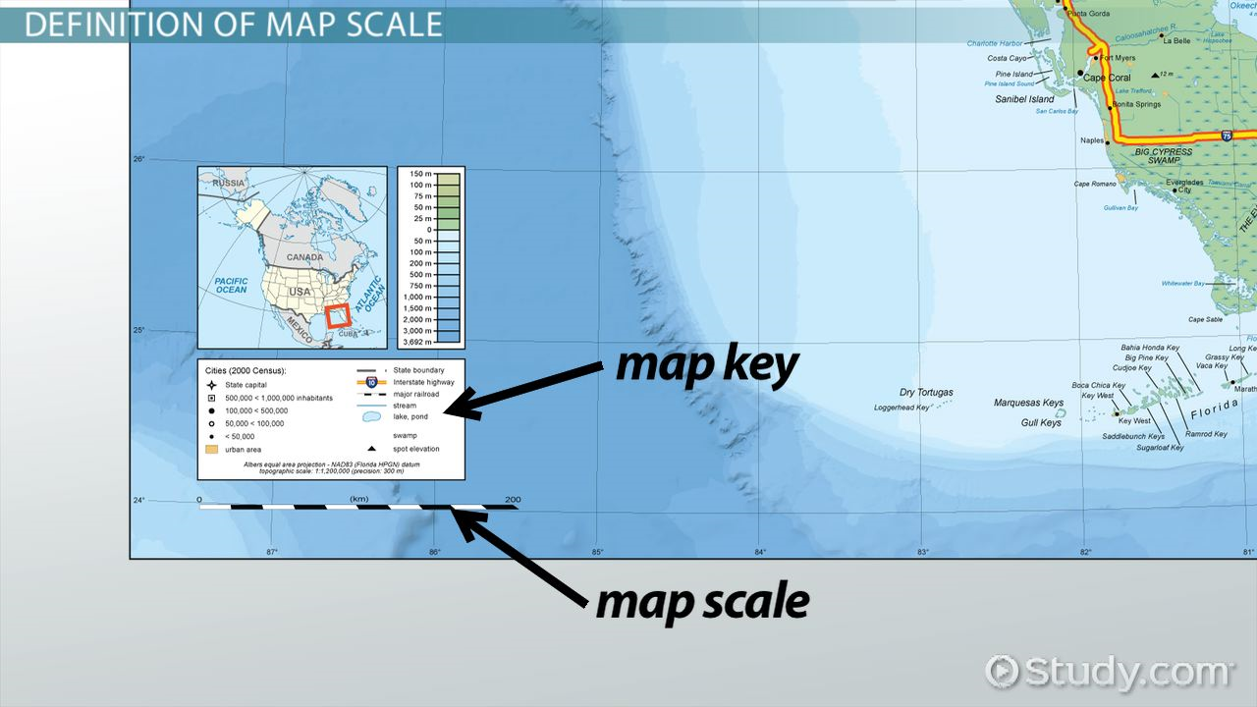

Slide 6


Slide 7
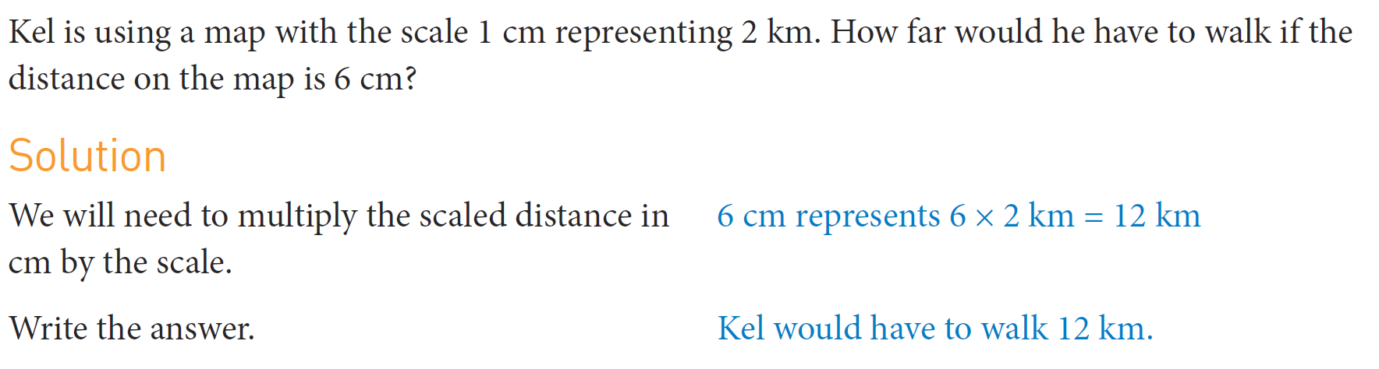
Practice

Slide 8
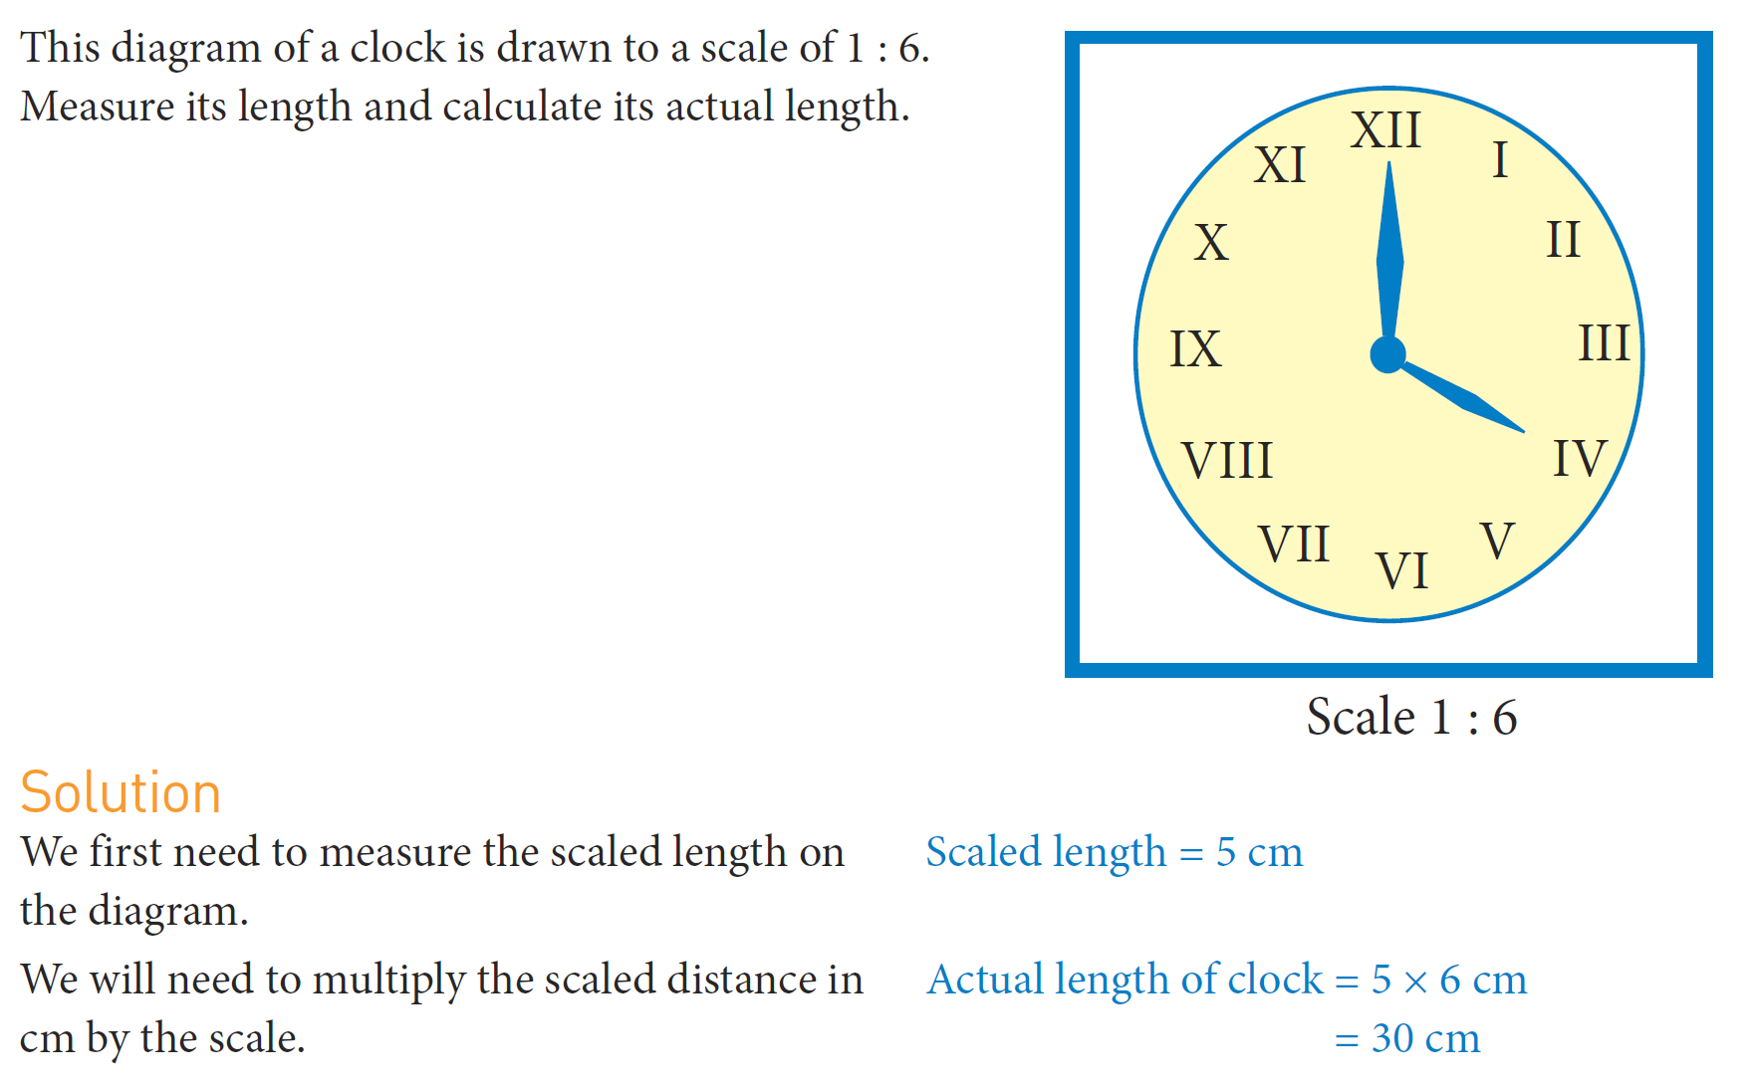
Practice
Cut up your photocopied sheet and glue in your INB

Slide 9
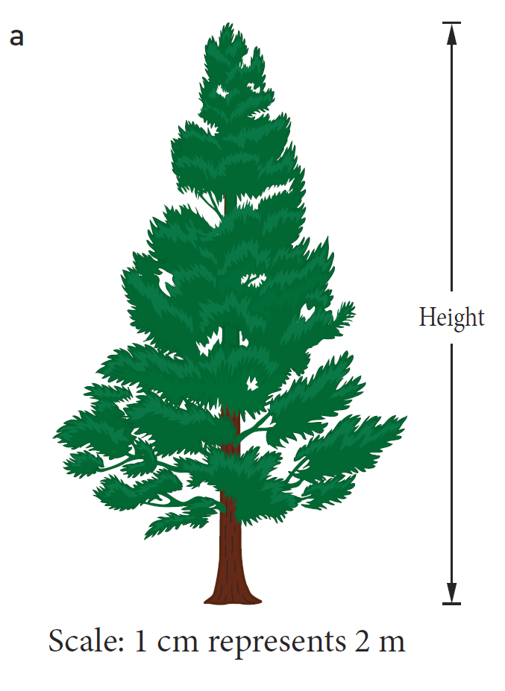
Practice
Cut up your photocopied sheet and glue in your INB

Slide 10
Task
T2W6_ Lesson 1_How to create Scale drawings worksheet

